Slide 1
IMDB Movie Analyze

Slide 2
What is business problem?
Microsoft decided to create a new studio. In this presentation you are going to see analyze of movies and recommendations to Microsoft to create a new studio.
What is business value ?
Since the budget of the movie will be millions of dollars, making a movie with a high gross is very important. This analysis can be used in order to see a high gross and prevent the movie from failing at the box office.

Slide 3

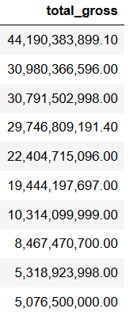
Data understanding
We have highest grossing studios and their total gross values in our data. This pictures you are seeing already sorted from top gross to bottom to find best studios.
Gross values could be hard to read however they are in billions.
This data shows us total 3387 movies between 2010-2018 years. Includes movies like ; Inception , Avengers, Harry Potter, Star Wars.

Slide 4
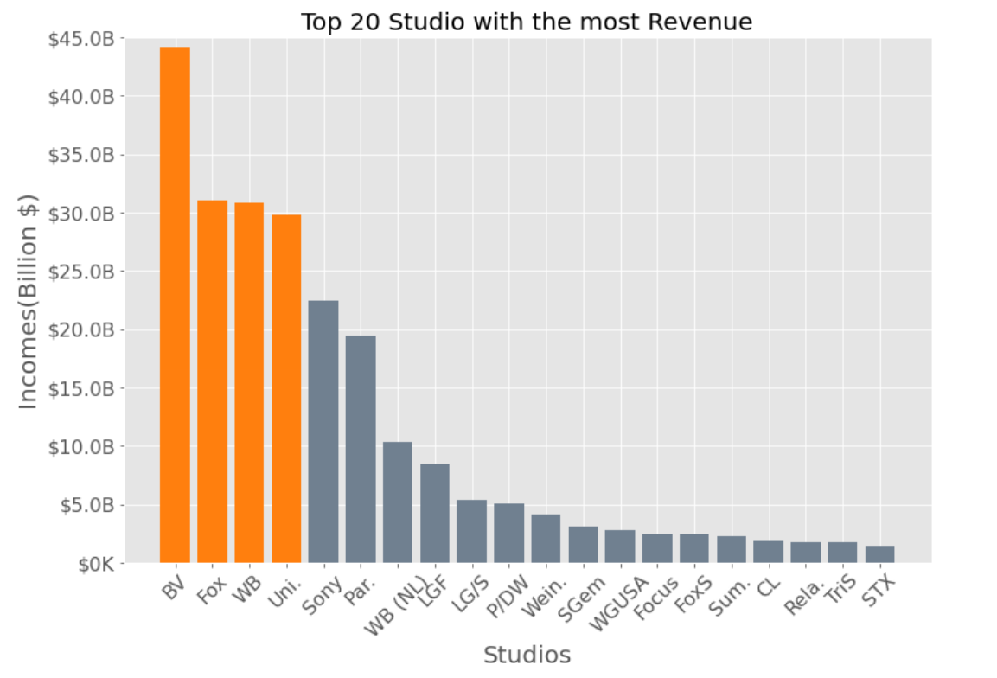
Top 20 Studios Graph
As we can see from this visualization BV,Fox,WB and Uni. Studios are the highest-grossing studios.

Slide 5
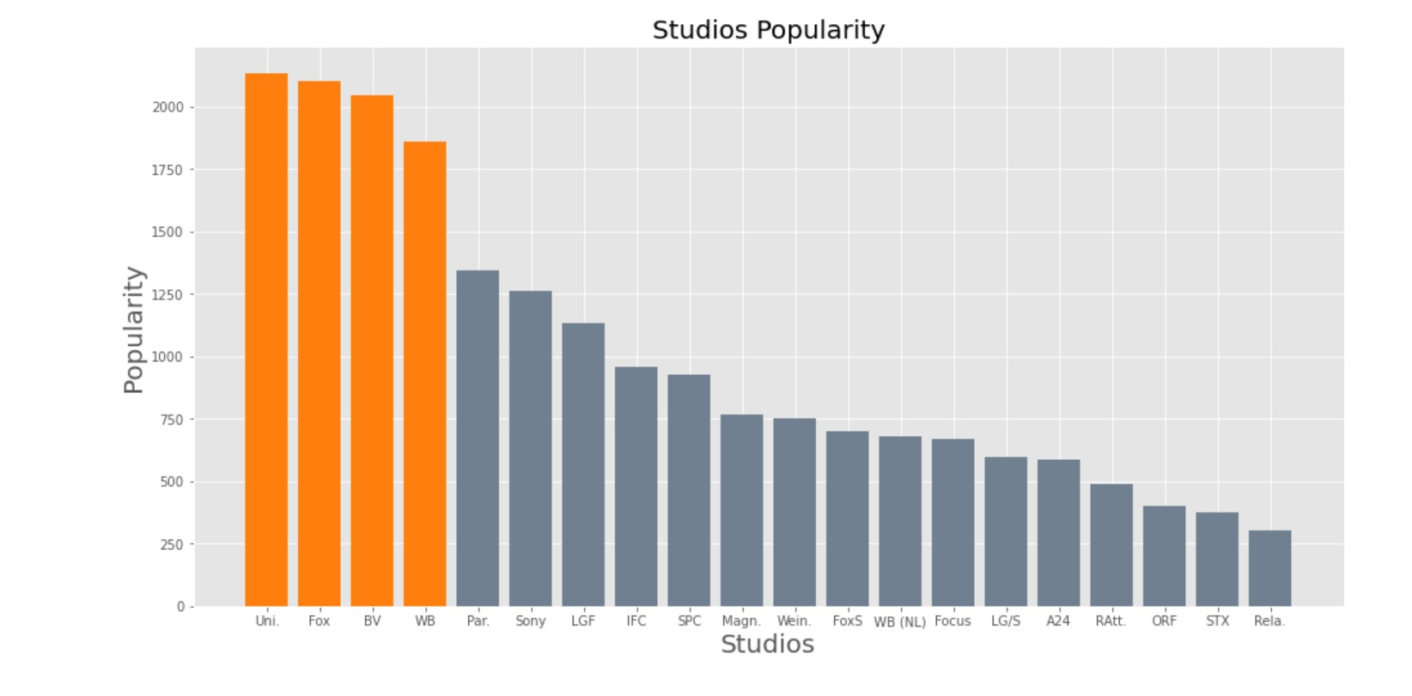
Studios Popularity
This graph supports the previous graph to show that higher-grossing studios are also the most popular ones.

Slide 6
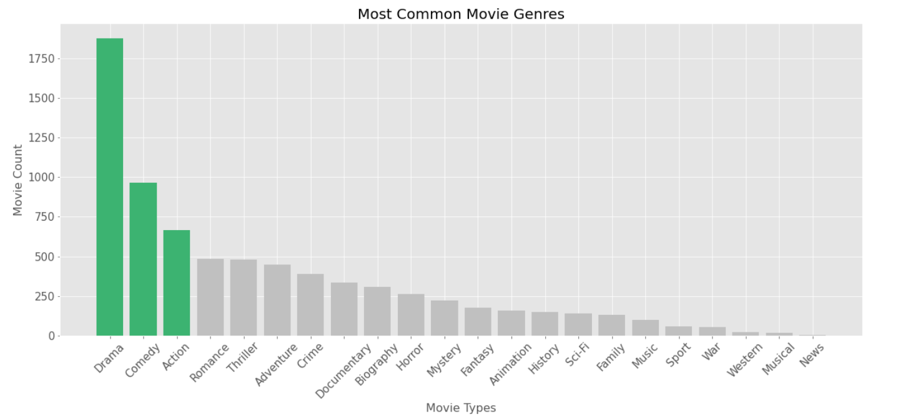
Looking the Most Common Movie Genres

Slide 7
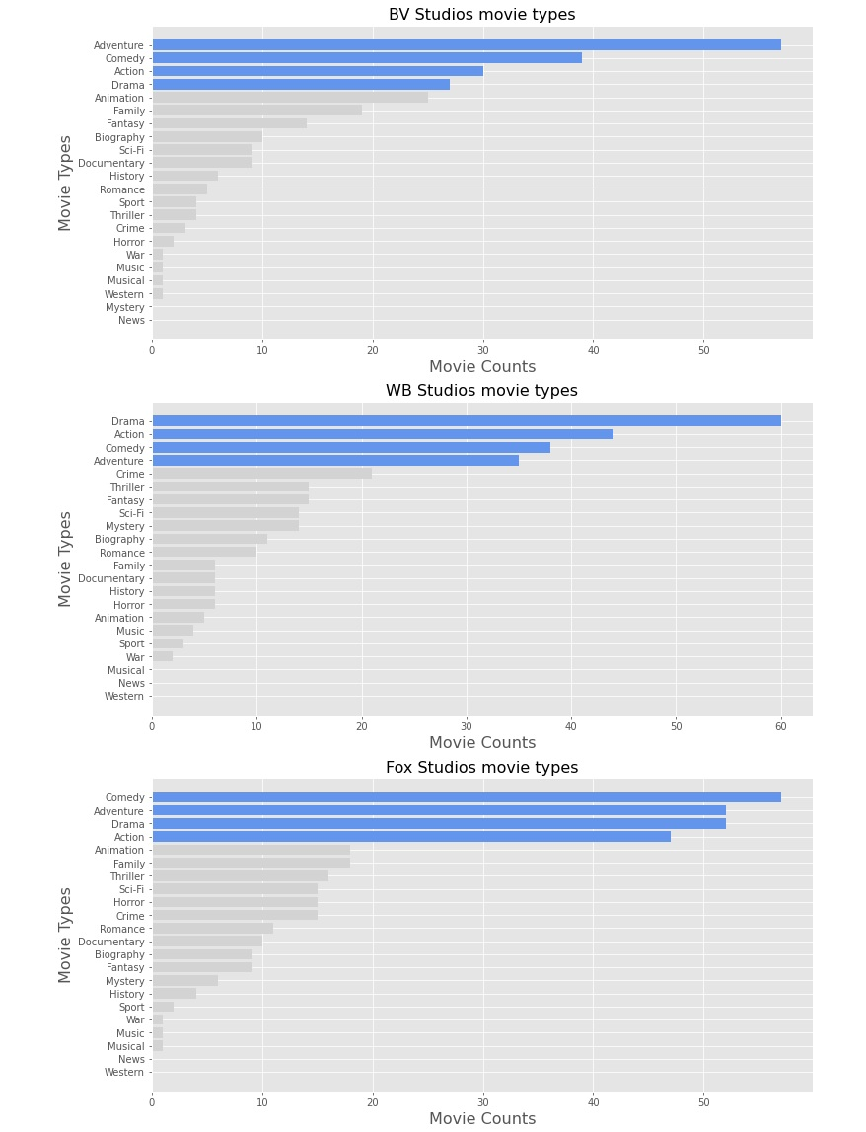
In here we wanted to show which first three of highest-grossing studios made type of movies.
And those types are ;
Adventure, Action, Drama and Comedy.

Slide 8
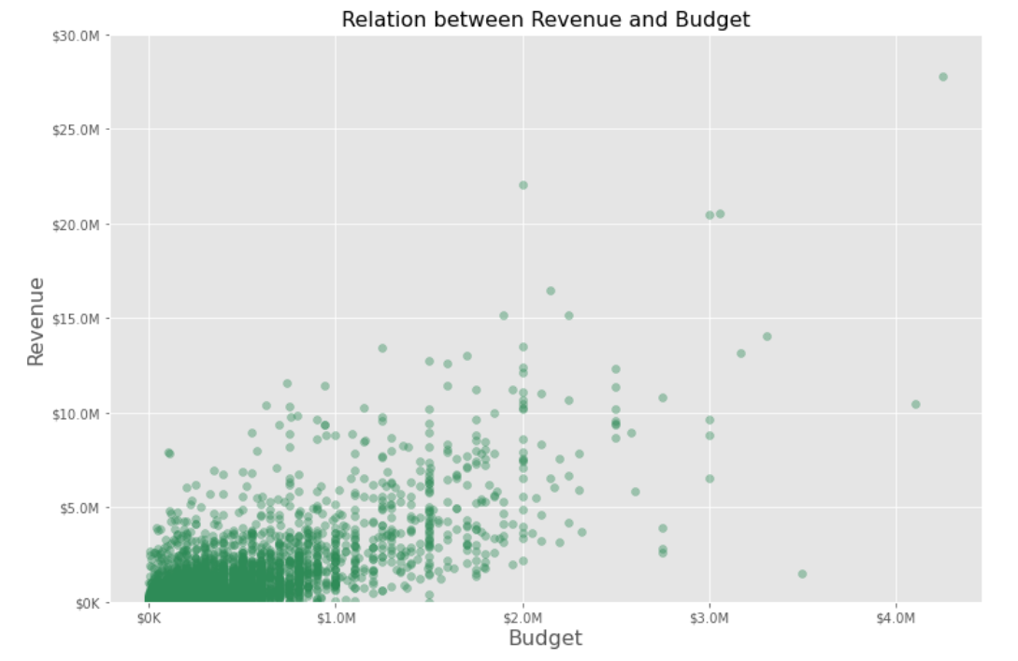
Budget-Revenue Relation
In this visualization is seen that the more budget provides the more revenue it comes.

Slide 9
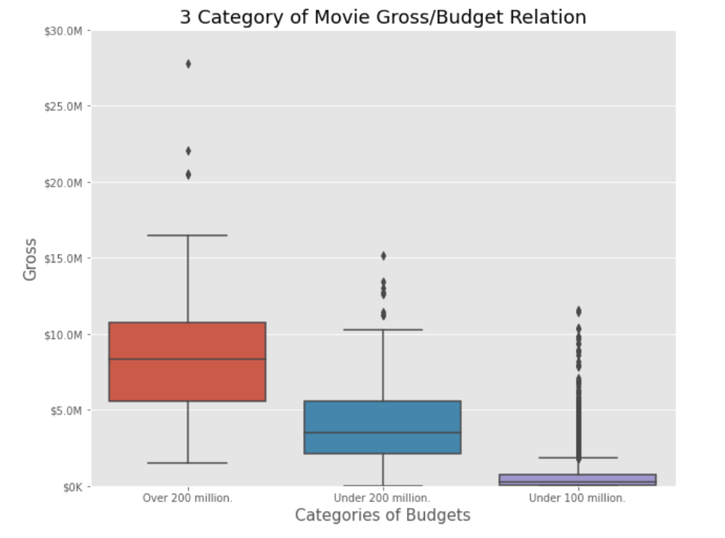
3 category of Budget-Revenue
In this graph easily could seen over 200 million category reaches the highest point of revenue
and under 100 million budget movies are the lowest revenue movies.

Slide 10
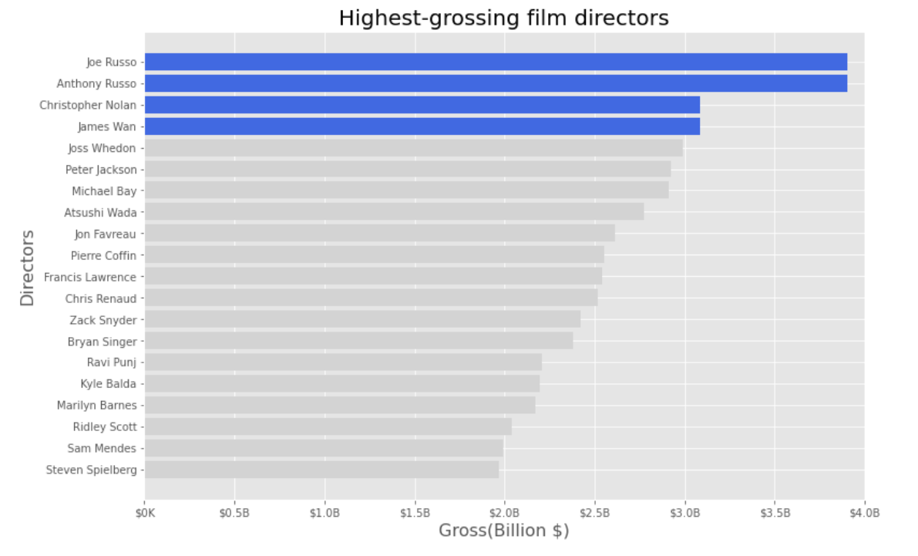
Highest-Grossing Directors

Slide 11
Conclusion
We can recommend to new studio to make movie with ;
One of these directors; Joe Russo, Anthony Russo,Christopher Nolan or James Wan.
On action,adventure,comedy or drama.
Give possible budget between 100 million to 300 million.
And further look what BV and Fox studios are doing to have most revenue and become most popular.

Slide 12
Future work
For future work if we have 6 more months and more budget to work on this project we could work on;
On movie names(if they affect audience,ratings,reviews).
On movie soundtracks.
On regulation/marketing theater dates.
Relations between directors and studios.

Slide 13


